Slide 1

Analysis 1: Foundations of Modeling Lesson 5.1: Sets
Analysis Team, 2020/2021

Slide 2
Overview of this lesson: Sets
Introduction to sets,
Definition, notation, cardinality, membership, equality,
Subsets, universal set and empty set,
Venn diagram,
Set operations,
Set-builder notation, interval, power set,
Cartesian product.

Slide 3
Overview of this lesson: Sets
Learning objectives:
Give brief introduction to sets and sets memberships and how to use a proper notation to represent them.
Learn about relations between the sets (equality, subset, proper subset).
Understand sets cardinality, powerset and Cartesian product.
At the end of the lesson a student should be able to:
Describe memberships of sets and relations between sets.
Determine the cardinality of a given set.
Perform the operations of union, intersection, complement, and difference on sets using proper notation.
Be able to draw and interpret Venn diagrams of set relations and operations.

Slide 4
Introduction to sets

Slide 5
Introduction to sets
What are sets?
How to represent sets?
notation
membership
order
equality
Why do we need them?

Slide 6
What is set?
Set = well defined collection of objects.
Well defined – does not vary from one person to another,
Collection – group,
Objects – items, numbers, entities, …
Notes:
Remind students that sets are one of the basic building blocks in mathematics.

Slide 7




What is set?
To define a set we have to define some property and group all objects with that property.
Examples:
{
}
{
}
a) days in week
b) items in my backpack
Monday
Tuesday
Wednesday
Thursday
Sunday
Friday
Saturday

Slide 8
Set notation
To “write” a set, you have to list each element, separated by a comma, …
… inside of curly brackets (set brackets, braces).
{
}
2, 3, 5, 7, 11, 13, 17,…
element = member
three dots (…) – infinite
a.k.a. ellipsis - - mean: continue on

Slide 9
Set notation and membership
Sets are typically represented by CAPTIAL LETTERS.
E.g. A = {a, b, c} B = { …, -3, -1, 1, 3, … } C = {1, 2, 3}
Let’s take a look at the first set, A. We can see it contains three elements, or members: a, b and c.
We can also write this as: a ∈ A, b ∈ A and c ∈ A.
‘∈’ – is a sign of relation, and is read as “element of”
Therefore, a ∈ A means: “a is element of set A”
The opposite relation is ‘∉’, and is read as “not element of”.
Therefore, d ∉ A means: “d is not element of set A”

Slide 10
Set order, cardinality
A set is container for objects and as such it doesn’t have order.
Therefore, {1, 2, 3} == {3, 1, 2}
Sets don’t have doubles!
Therefore, {1, 2, 2, 3} == {1, 2, 3}
Cardinality = the size of the set – how many members that set has.
Example, set A = {1, 2, 3} has cardinality 3 (i.e. n(A) = 3 or |A| = 3).
Set B = {a, b, c, d} has cardinality 4 (i.e. n(B) = 4 or |B| = 4).

Slide 11
Set equality
Sets are equal if they precisely have the same members.
Example:
A is the set of the first five odd positive whole numbers,
B = {3, 1, 9, 5, 7}
If we check cardinality of A and B, we conclude that both have exactly 5 members.
Also: 1 ∈ A, 3 ∈ A, 5 ∈ A, 7 ∈ A, 9 ∈ A
1 ∈ B, 3 ∈ B, 5 ∈ B, 7 ∈ B, 9 ∈ B
Therefore, we conclude that sets A and B are equal.
A = B

Slide 12
Why do we need sets?
Sets are essential building block of mathematics.
On their own, they may seem non-important, but almost every branch of mathematics relies on sets in a certain way.
Computer science also relies on sets and set theory.
With sets we can build more complex mathematical structures.

Slide 13
Subsets, universal set and empty set

Slide 14
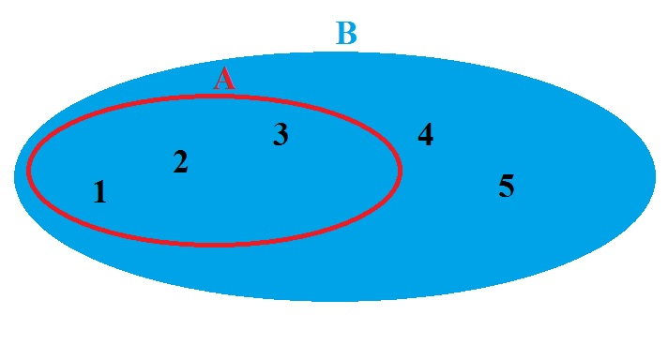
Subset
A set A is a subset of another set B if all elements of the set A are elements of the set B.
This implies, the set A is contained inside the set B.
The subset relationship is denoted as: A ⊆ B.
SET: B = {1, 2, 3, 4, 5}
SUBSET: A = {1, 2, 3}

Slide 15
Proper subset
Using the definition from the previous slide leads to a dilemma:
Let A be a set.
Is every element in A also element in A?
??? Well, of course! It is the same set !
Then, applying the definition, does it mean that A is also subset of A?
The answer is actually true.
Therefore, each set is also its’ own subset.
If we want to distinguish from this border case, we have to introduce a new term: proper subset.

Slide 16
Proper subset
Proper subset, definition:
A is a proper subset of B if and only if every element in A is also in B, and there exists at least one element in B that is not in A.
Therefore {1, 2, 3, 4, 5} is a subset of {1, 2, 3, 4, 5} but is not a proper subset.
While {1, 2, 3, 4} is a proper subset of {1, 2, 3, 4, 5}.
The notation for proper subset is: ⊂ (sometimes also ⊊).
Therefore we can write: {1, 2} ⊂ {1, 2, 3} or {1,2} ⊊ {1, 2, 3}
{1, 2, 3} ⊆ {1, 2, 3}

Slide 17
Subsets - notation
Relation | Symbol | Example
subset | ⊆ | {1, 2, 3} ⊆ {1,2, 3}
proper subset | ⊂ or ⊊ | {1,2} ⊂ {1,2, 3}
superset | ⊇ | {1, 2, 3} ⊇ {1,2, 3}
proper superset | ⊃ or ⊋ | {1, 2, 3} ⊃ {1, 2}
not a strict subset of | ⊄ | {1, 5} ⊄ {1, 2, 3}
not a strict superset of | ⊅ | {1, 2, 3} ⊄ {1, 5}
not a subset (nor equal to) | ⊈ | {1, 5} ⊈ {1, 2, 3}
not a superset (nor equal to) | ⊉ | {1, 2, 3} ⊉ {1, 5}

Slide 18
Universal set and empty set
In a broad sense, a universal set is a set that contains ‘everything’ that is relevant to our question.
Note: this will be made clear with Venn diagrams.
It is also possible to have a set with NO ELEMENTS. Such set is called the empty set.
We can write the empty set as A = {} or A = ∅.
Note: the empty set is a subset of every set!

Slide 19
Venn diagram and set operations

Slide 20
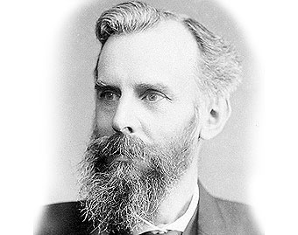
Venn diagram
John Venn (1834 - 1923)
English mathematician, philosopher.
Further developed Boole’s theories (book: Symbolic Logic)
Credited with invention of Venn’s diagram.
A Venn diagram - is a diagram that shows all possible logical relations between a finite collection of different sets.
These diagrams depict elements as points in the plane, and sets as regions inside closed curves.

Slide 21
Venn diagram
T
Let T be a set of teachers:
Aninka,
Bas,
Casper,
Daphne,
Elke,
Floor.
T = {Anninka, Bas, Casper, Daphne, Elke, Floor}
Aninka
Casper
Bas
Daphne
Elke
Floor

Slide 22
Venn diagram
Next, let’s assume they have hobbies.
Let F denote a set of football players: F = {Bas, Casper, Daphne}
Let H denote a set of those that are doing equestrian sports:
H = {Daphne, Elke, Floor}
F
H
Daphne
Floor
Bas
Elke
Casper
Daphne

Slide 23
Venn diagram
However, since Daphne both rides horses and plays football, it is appropriate to put her into intersection.
Aninka is not doing any sports, but she is a teacher. So, we have to add her too.
H
T
F
Bas
Elke
Daphne
Casper
Floor
Aninka

Slide 24
Venn diagram
Thanks to Venn diagram it is easy to identify sets and their members:
Universal set T, T = {Aninka, Bas, Casper, Daphne, Elke, Floor}
Football players F, F = {Bas, Casper, Daphne}
Horse riders H, H = {Daphne, Elke, Floor}
F
H
T
Bas
Elke
Daphne
Casper
Floor
Aninka

Slide 25
Venn diagram
With Venn Diagram you can quickly find membership, for example:
Casper ∈ F, therefore, Casper plays football.
Daphne ∈ F, but also Daphne ∈ H, so she does both sports.
Elke ∉ F, therefore Elke doesn’t play football.
F
H
T
Bas
Elke
Daphne
Casper
Floor
Aninka

Slide 26
Union
Definition: Union of two given sets is the smallest set which contains all the elements of both sets.
To find the union of two given sets A and B is a set which consists of all the elements of A and all the elements of B such that no element is repeated.
The symbol for denoting union of sets is: ‘∪’
Example: A = {1, 2, 3, 5, 8}, B = {1, 3, 4, 5, 7}
A ∪ B = {1, 2, 3, 4, 5, 7, 8}

Slide 27
Union
In our example, F ∪ H would be all teachers that play football OR do equestrian sports.
F ∪ H = {Bas, Casper, Daphne, Elke, Floor}
H
T
F
Bas
Elke
Daphne
Casper
Floor
Aninka

Slide 28
Intersection
Definition: Intersection of two given sets is the largest set which contains all the elements that are common to both sets.
To find the intersection of two given sets A and B is a set which consists of all the elements which are common to both A and B.
The symbol for denoting intersection of sets is: ‘∩’
Example: A = {1, 2, 3, 5, 8}, B = {1, 3, 4, 5, 7}
A ∩ B = {1, 3, 5}

Slide 29
Intersection
In our example, F ∩ H would be all teachers that play football AND do equestrian sports.
F ∩ H = {Daphne}
T
F
H
Bas
Elke
Daphne
Casper
Floor
Aninka

Slide 30
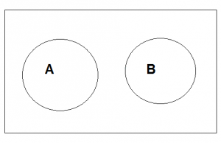
Disjoint sets
Definition: Two sets are disjoint sets if their intersection is the empty set.
Example:
A = {1, 3, 5} B = {2, 4}
Sets A and B are disjoint as A ∩ B = ∅

Slide 31
Difference
Definition: (Set) difference of two sets A and B is the largest subset of set A such that none of its elements are members of set B.
All elements of the first set, that are not the elements of the second.
The symbol for denoting (set) difference is: ‘-’
Example: A = {1, 2, 3, 5, 8}, B = {1, 3, 4, 5, 7}
A – B = {2, 8}
B – A = {4, 7}
Note: A – B ≠ B – A

Slide 32
Difference
In our example, F - H would be all teachers that only play football AND do NOT DO equestrian sports.
F - H = {Bas, Casper}
T
F
H
Bas
Elke
Daphne
Casper
Floor
Aninka

Slide 33
Universal set
In our example, universal set is the one containing ALL the teachers. That is set T.
T = {Aninka, Bas, Casper, Daphne, Elke, Floor}
T
F
H
Bas
Elke
Daphne
Casper
Floor
Aninka

Slide 34
Complement of a set
Definition: if ξ is the universal set and A a subset of ξ, then the complement of A is the set of all elements of ξ which are not the elements of A.
To denote a complement of a set add either ‘^{c}’ or ‘'’ (A^{c} or A')
Example: A = {1, 2, 3, 5, 8}, ξ = {1, 2, 3, 4, 5, 6, 7, 8, 9}
A^{c} = ξ – A = {4, 6, 7, 9}
Notes:
ξ – pronounced “Xi”

Slide 35
Complement of a set
In our example, F^{c} - would be all teachers that DON’T play football.
F^{c} = {Elke, Floor, Aninka}
T
F
H
Bas
Elke
Daphne
Casper
Floor
Aninka

Slide 36
Set-builder Notation and Intervals

Slide 37
Common Number Sets
For many aspect of mathematics and algebra, it is useful to be able to discuss a subset of all the known numbers.
N – Natural numbers (whole numbers from 1 upwards)
Z – Integers (whole and negative numbers + zero)
Q – Rational numbers (fractions [e.g. 10/4 = 2.5, -1/10 = -0.1])
R – Real numbers (any point on a number line [e.g. √2, 𝜋 ])
I – Imaginary numbers (give negative result when squared)
C – Complex numbers (combination of real and imaginary)

Slide 38
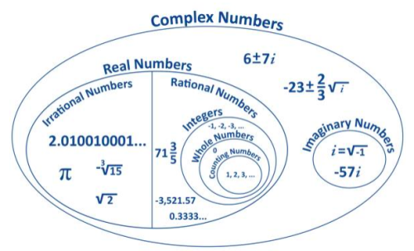
Common Number Sets

Slide 39
Set-builder notation
Until now, we have been building sets by explicitly declaring their members.
This becomes inefficient as the cardinality increases, therefore we need a generic approach.
For set A = {1, 2, 3, 4, 5, 6, 7, 8, 9, 10, 11, 12, 13, 14, …} we could have also stated that it is a set of all x, where each x is greater than 0.
We can express this like:
A = {x | x > 0 }

Slide 40
Set-builder notation
Let’s take a look of this set-builder notation in detail
{
x
|
x > 0
}
the set of
all x
such that
x is greater than 0

Slide 41
Set-builder notation
If we want to build a set A of all integers that are less than or equal to 10, we can simply use the following notation:
A = {x ∈ Z | x ≤ 10 }
In the same manner we can also limit the interval.
For example, set B of all real numbers beginning with (including) 1 and ending with (including) 8.
A = {x ∈ R | x ≥ 1 and x ≤ 8 }

Slide 42
Set-builder notation (exercise)
What is the cardinality (how many members) of the set A created with the following notation:
A = {x ∈ Z | x = x² }
Answer: n(A) = 2
A = {0, 1}, because only 0² = 0 and 1² = 1

Slide 43
Interval
Interval = all numbers between two given numbers.
Notation:
Open interval ( ) - e.g. (a, b) a < x < b
Closed interval [ ] - e.g. [a, b] a ≤ x ≤ b
You can have intervals open on left and closed on right and vice-versa; e.g. (a, b] or [a, b)
Infinity (∞) is often used in interval notation:
(a, +∞) x > a “greater than a”
(-∞, b] x ≤ b “less than or equal to b”

Slide 44
Interval
Note: infinity is NOT NUMBER, therefore you must always have OPEN interval next to it.
This is wrong: (a, +∞]
You can use union (U) and intersection (∩) to join multiple intervals.
For example:
(-∞, -5] U (10, +∞) x ≤ -5 or x > 10
(-∞, 5] ∩ (1, ∞) x > 1 and x ≤ 5 (1, 5]

Slide 45
Power Set

Slide 46
Power set
Power set is a set of ALL subsets of a set.
The notation for power set is capital letter P.
Let’s try to enumerate all subsets on a simple case: S = {1, 2}
We can start with obvious {1} and {2}, but is that all?
As {1, 2} ⊆ {1, 2} it is also part of the power set. Any other?
Often overlooked, ∅ is also part of the power set as ∅ ⊂ {1, 2}.
Therefore, P(S) = {{1}, {2}, {1, 2}, ∅}
n(P(S)) = 4

Slide 47
Power set
Let A = {1}. What is P(A)?
Answer: P(A) = {{1}, ∅}
n(P(A)) = 2
Let B = {1, 2, 3}. What is P(B)?
Answer: P(B) = {{1}, {2}, {3}, {1,2}, {1,3}, {2,3}, {1,2,3}, ∅}
n(P(B)) = 8

Slide 48
Power set
Suppose we have set A, where n(A) = 10. Enumerating all elements to determine n(P(A)) would take quite an effort. Let’s see if we can identify a pattern …

Slide 49
Power set
n
2^{n}
S | n(S) | P(S) | n(P(S))
{1} | 1 | {{1}, ∅} | 2
{1,2} | 2 | {{1}, {2}, {1, 2}, ∅} | 4
{1,2,3} | 3 | {{1}, {2}, {3}, {1,2}, {1,3}, {2,3}, {1,2,3}, ∅} | 8
{1,2,3,4} | 4 | {{1}, {2}, {3}, {4}, {1,2}, {1,3}, {1,4}, {2,3}, {2,4}, {3,4}, {1,2,3}, {1,2,4}, {1,3,4}, {2,3,4}, {1,2,3,4}, ∅} | 16

Slide 50
Power set
Therefore, for set A such that n(A) = 10,
n(P(A)) = 2¹⁰ = 1024

Slide 51
Cartesian product

Slide 52
Cartesian product
The Cartesian product of two sets A and B, denoted A × B, is the set of all possible ordered pairs where the elements of A are first and the elements of B are second.
In set-builder notation, A × B = {(a, b) : a ∈ A and b ∈ B}.
Example: Let A = {∝, β} and B = {1, 2, 3}.
A × B = {(∝, 1), (∝, 2), (∝, 3), (β, 1) , (β, 2) , (β, 3)}
Also:
|A × B| = |A| * |B| = 2 * 3 = 6
Cartesian product is also known as cross product.

Slide 53
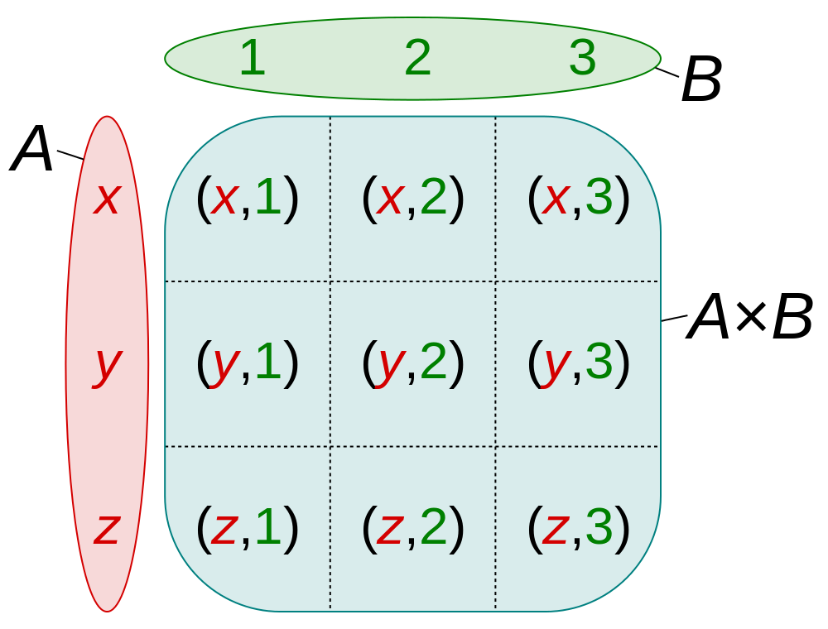
Cartesian product
Source: Wikipedia, Cartesian product

Slide 54
Cartesian product
Typical example of Cartesian product is the standard 52 card deck.
Let A be a 13 element set of standard playing card ranks:
A = {2, 3, 4, 5, 6, 7, 8, 9, 10, J, Q, K, A}
Let B be a 4 element set of standard playing card suits:
B = {♠, ♥, ♦, ♣}
The standard 52 card deck is the Cartesian product of A and B:
A × B = {2♠, 2♥, 2♦, 2♣, 3♠, 3♥, 3♦, 3♣, … , A♠, A♥, A♦, A♣}

Slide 55
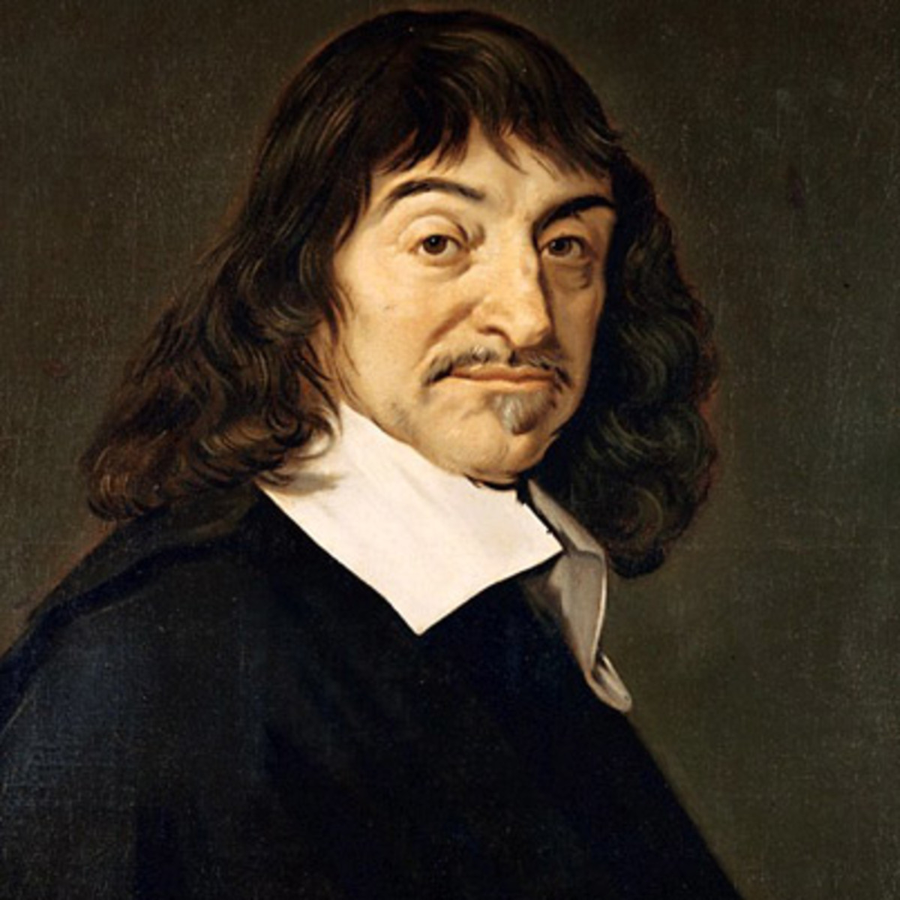
Cartesian coordinates
René Descartes (1596 - 1650)
French mathematician, philosopher, scientist.
One of the most notable intellectual figures of Dutch Golden Age.
Regarded as one of the founders of modern philosophy.
“I think; therefore I am.”
Descartes ideas lead to the creation of coordinate system – Cartesian coordinate system.
United ideas of algebra and geometry, allowing a new way to visualize mathematics → analytical geometry.

Slide 56
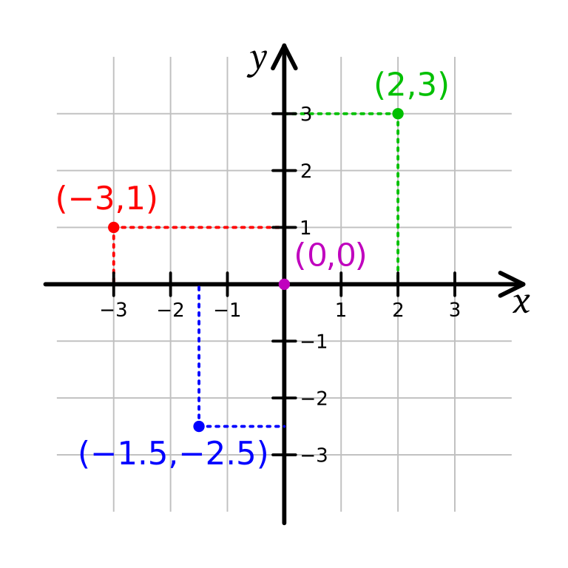
Cartesian coordinates
The Cartesian coordinates in the plane are specified in terms of the x coordinates axis and the y coordinate axis.
The origin is the intersection of the x and y-axes.
The Cartesian coordinates of a point in the plane are written as (x,y).

Slide 57
Cartesian coordinates
The first number x is called the x-coordinate = the signed distance from the origin in the direction along the x-axis.
The x-coordinate specifies the distance to the right (if x is positive) or to the left (if x is negative) of the y-axis.
The second number y is called the y-coordinate = the signed distance from the origin in the direction along the y-axis
The y-coordinate specifies the distance above (if y is positive) or below (if y is negative) the x-axis.

Slide 58
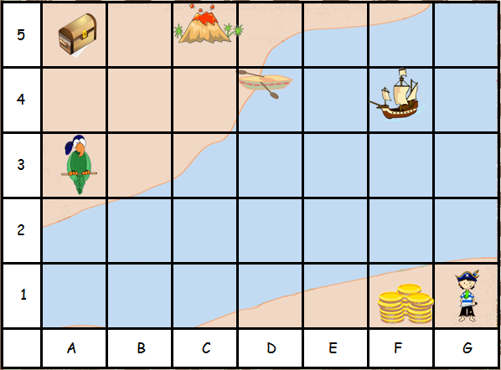
Cartesian coordinates
Exercise:
What are the coordinates for:
parrot?
treasure chest
volcano?
pirate ship?
gold coins?
Notes:
A3
A5
C5
F4
F1

Slide 59
Summary Quiz
What is set?
Which notation do we use for representing sets?
What does the sign ‘∈’ mean?
Does set have order? Can it have doubles?
What is cardinality?
When are two sets equal?
What is a subset?
What is a proper subset?
What is universal set?
What is the empty set?
What is Venn diagram?
What is union?

Slide 60
Summary Quiz
What is intersection?
What are disjoint sets?
What is set difference?
What is set complement?
What is set-builder notation? Why do we use it?
What are intervals?
What is power set?
What is Cartesian product?
What is Cartesian coordinate system?

Slide 61
Summary
Set is well defined collection of objects. We say “well defined” because it does not vary from one person to another, “collection” as it means group, and “objects” as any entity, number, or item we want to include. Set is a group of all objects with some specific property.
Sets are typically represented by capital letters. The members of a set are given inside of curly brackets (braces), separated by commas (‘,’).
‘∈’ is a sign of relation, and is read as “element of”. It is used to show if an element is a member of given set.
A set is container for objects and as such it doesn’t have order, nor can it have doubles.
Cardinality is the size of the set. It shows how many members that set has. The notation for cardinality (for example set A) is n(A) or |A|.
Sets are equal if they precisely have the same members.
A set A is a subset (‘ ⊆ ’)of another set B if all elements of the set A are elements of the set B.

Slide 62
Summary
A set is a proper subset of another set if and only if every element in the first set is also in second set, and there exists at least one element in the second set that is not in first set.
A universal set ( ξ ) is the set containing all objects or elements and of which all other sets are subsets.
The empty set ( ∅ ) is the unique set that has no elements. Its size or cardinality is zero.
A Venn diagram - is a diagram that shows all possible logical relations between a finite collection of different sets.
Union ( ∪ ) of two given sets is the smallest set which contains all the elements of both sets.
Intersection ( ∩ )of two given sets is the largest set which contains all the elements that are common to both sets.
Two sets are disjoint sets if their intersection is the empty set.
Set difference of two sets A and B is the largest subset of set A such that none of its elements are members of set B.

Slide 63
Summary
Complement of a set is the set of all elements of universal set ξ which are not elements of that set.
Set-builder notation is a way to describe a set by saying what properties its members have. For example: all integers less or equal to 10 {x ∈ Z | x ≤ 10 }.
Interval are all numbers between two given numbers. We distinguish between open intervals ‘(’ and ‘)’ and closed intervals ‘[’ and ‘]’.
Power set is a set of ALL subsets of a set. For a set S with n elements, the cardinality of its power set is 2^{n} elements.
The Cartesian product (or cross product) of two sets A and B, (A × B ) is the set of all possible ordered pairs where the elements of A are first and the elements of B are second.

Slide 64
Summary
A Cartesian coordinate system is a coordinate system that specifies each point uniquely in a plane by a set of numerical coordinates, which are the signed distances to the point from two fixed perpendicular oriented lines, measured in the same unit of length. Each reference line is called a coordinate axis or just axis (plural axes) of the system, and the point where they meet is its origin, at ordered pair (0, 0). The coordinates can also be defined as the positions of the perpendicular projections of the point onto the two axes, expressed as signed distances from the origin.

Slide 65
Extra material - videos
Disclaimer:
The following videos are not part of the course material, and as such, are treated as an extra information. The teaching team believes it is beneficial to the students to also have the topics presented from a different perspective. Some video will provide more information that given at the lesson, some less.
For the exam, the only relevant information is considered the one given by the teachers and written in the course book.
To understand the topics better, using external sources, like the videos given below, is strongly recommended. Feel free to explore, and ask your teacher should you have any questions.

Slide 66

Introduction to sets
Notes:
URL:
https://www.youtube.com/watch?v=tyDKR4FG3Yw

Slide 67

Subsets and power sets
Notes:
URL:
https://www.youtube.com/watch?v=H5D6EAezsXQ

Slide 68
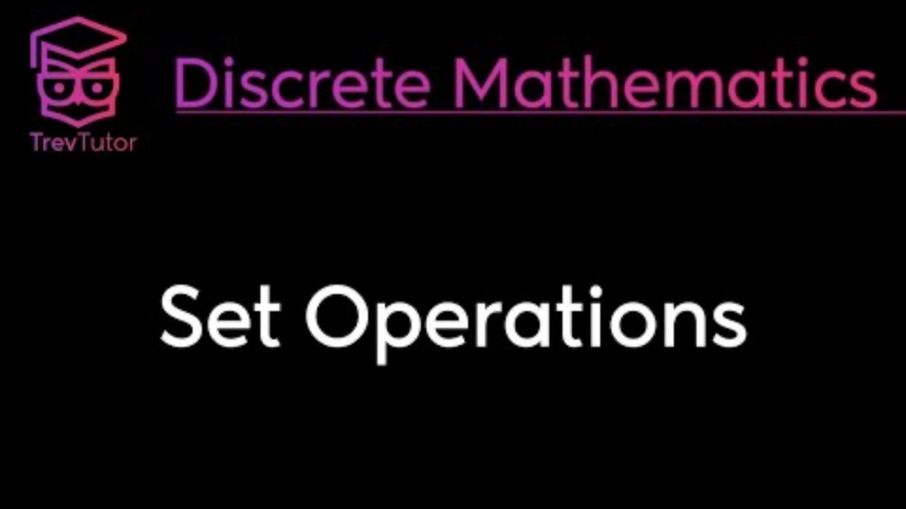
Set operations
Notes:
URL:
https://www.youtube.com/watch?v=4TlCToZZ5gA

Slide 69
Several videos about sets from MyWhyU
Defining sets: https://www.youtube.com/watch?v=GYlhVuGBl5E&t
Set equality and subsets: https://www.youtube.com/watch?v=OYGYqRj9-ok
Venn diagrams, unions, intersections: https://www.youtube.com/watch?v=uR70knMr2Hg
Complement and relative complement: https://www.youtube.com/watch?v=EopnMNEXV64

Slide 70
Several videos about sets from MyWhyU
Interval notation and the number line: https://www.youtube.com/watch?v=JQuPaIYsivY
Bounded versus unbounded intervals: https://www.youtube.com/watch?v=hajHB1XlKw0
Union of intervals: https://www.youtube.com/watch?v=U8FxJ_XKFNQ
Cartesian product: https://www.youtube.com/watch?v=l4j4XgVbuxc
Cartesian coordinate system: https://www.youtube.com/watch?v=RrrYInyIEGo

